Slide 1
Influence Maximization
Raj Patel - 201901306
Vishv Joshi - 201901453
Ashray Kothari - 201901457

Slide 2
Table of contents
01
Problem Statement
02
Network Analysis
03
Influence Maximization
04
References

Slide 3
01
Problem Statement

Slide 4
Finding influential people in a social network is a challenge since it involves choosing the few members who will eventually impact the greatest number of others in the network.
Many businesses and people interested in promoting their goods, services, and original ideas would be interested in this topic, also known as ‘influence maximisation’.

Slide 5
02
Network Analysis

Slide 6
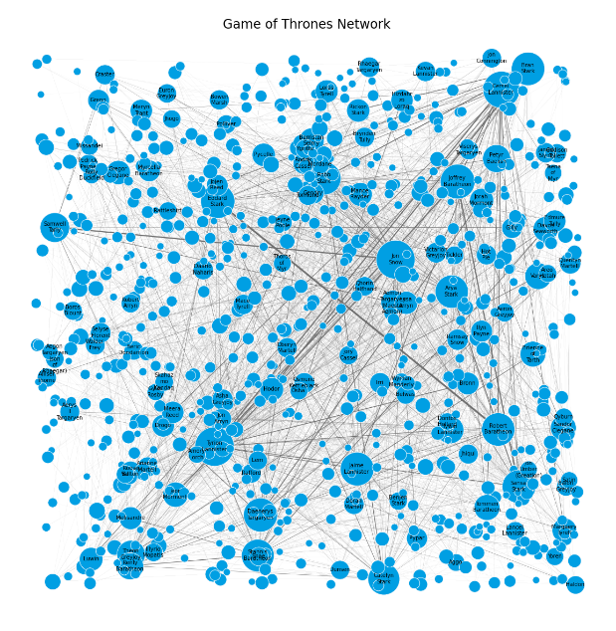
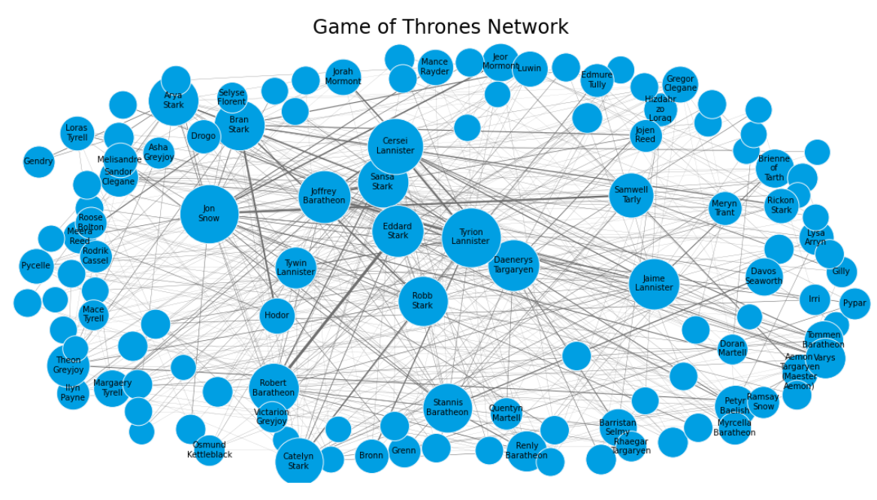
Network Visualization
Complete Network
Sub-Network

Slide 7
Network Statistics
# Nodes
# Edges
Diameter
Avg. Path Length
Transitivity
Density
Avg. Clustering Coefficient
Connected Components
124
985
4
2.237
0.430
0.129
0.634
1

Slide 8
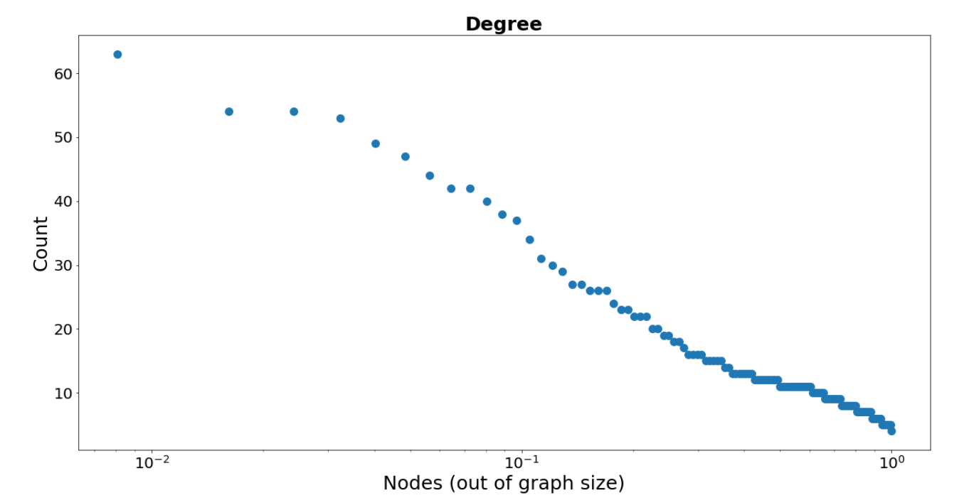
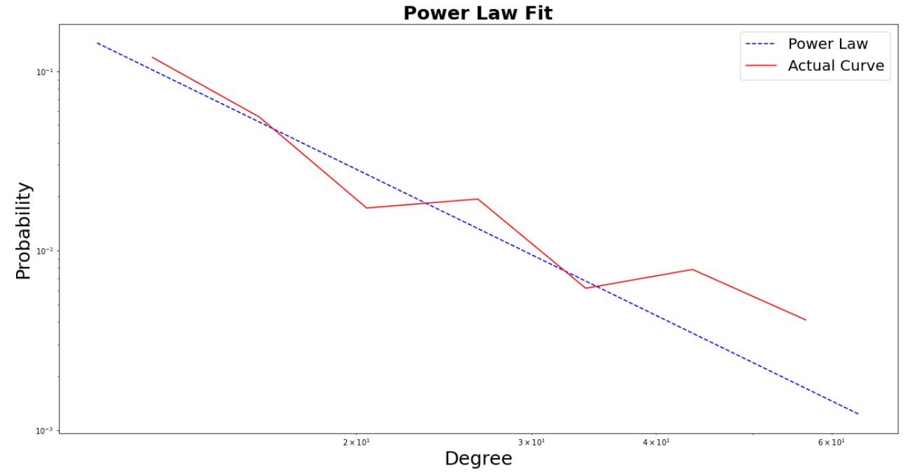
Power-Law Analysis
𝝰 = 2.708

Slide 9
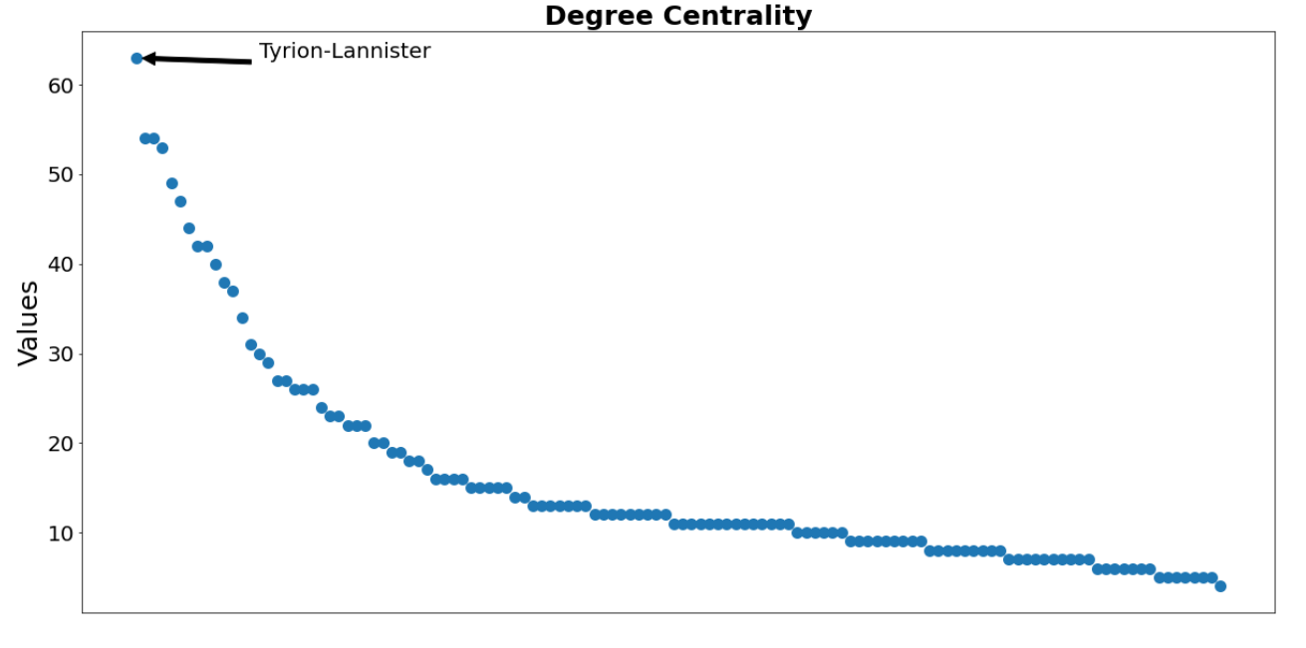
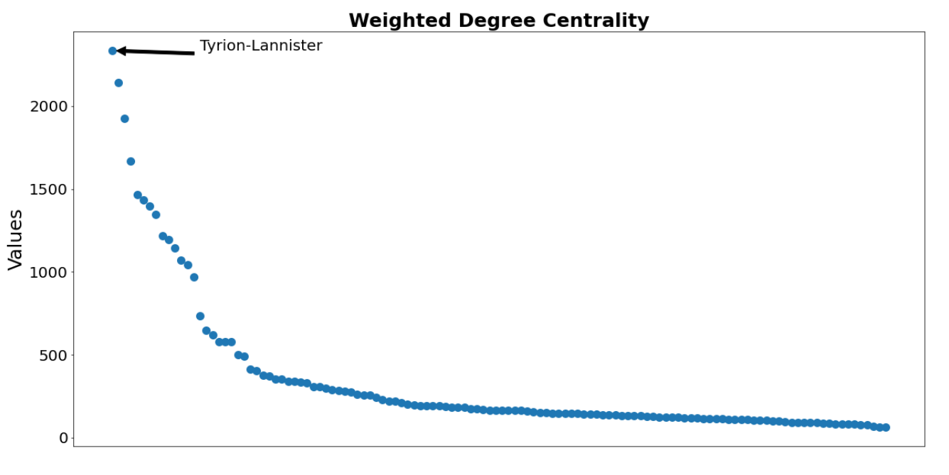
Centrality Measures

Slide 10
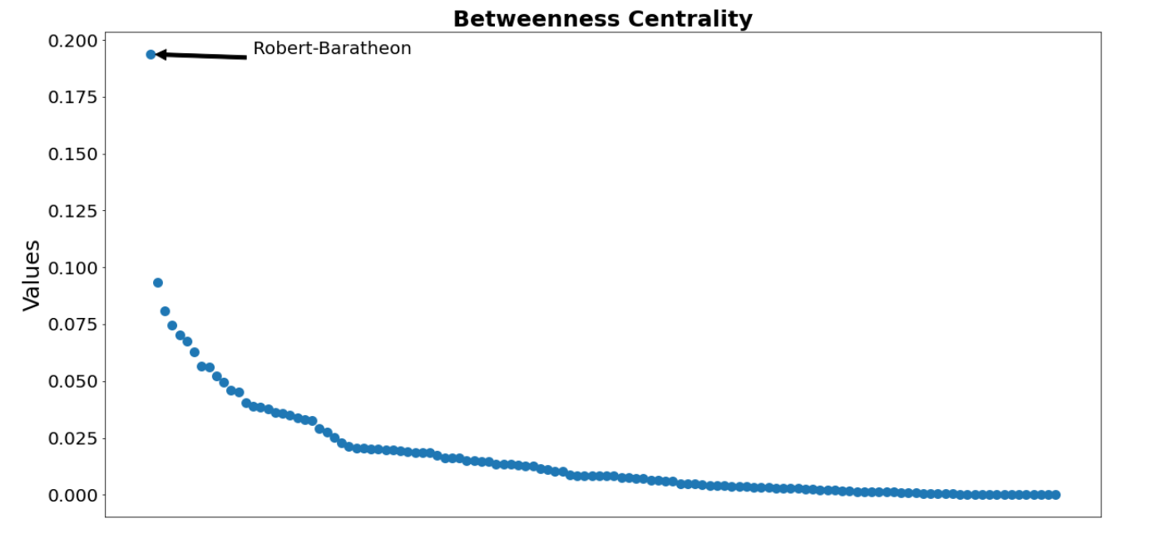
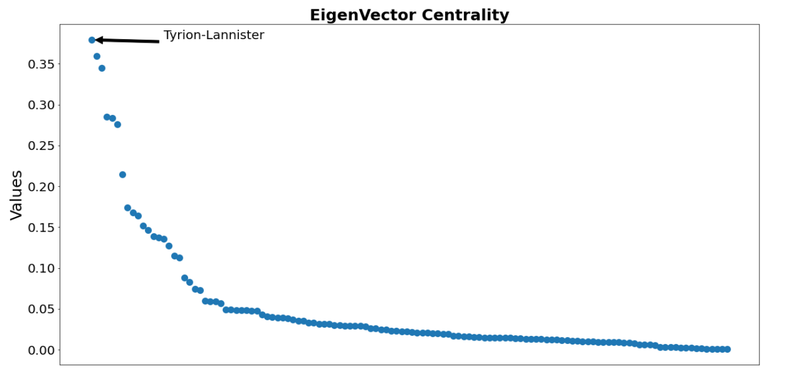
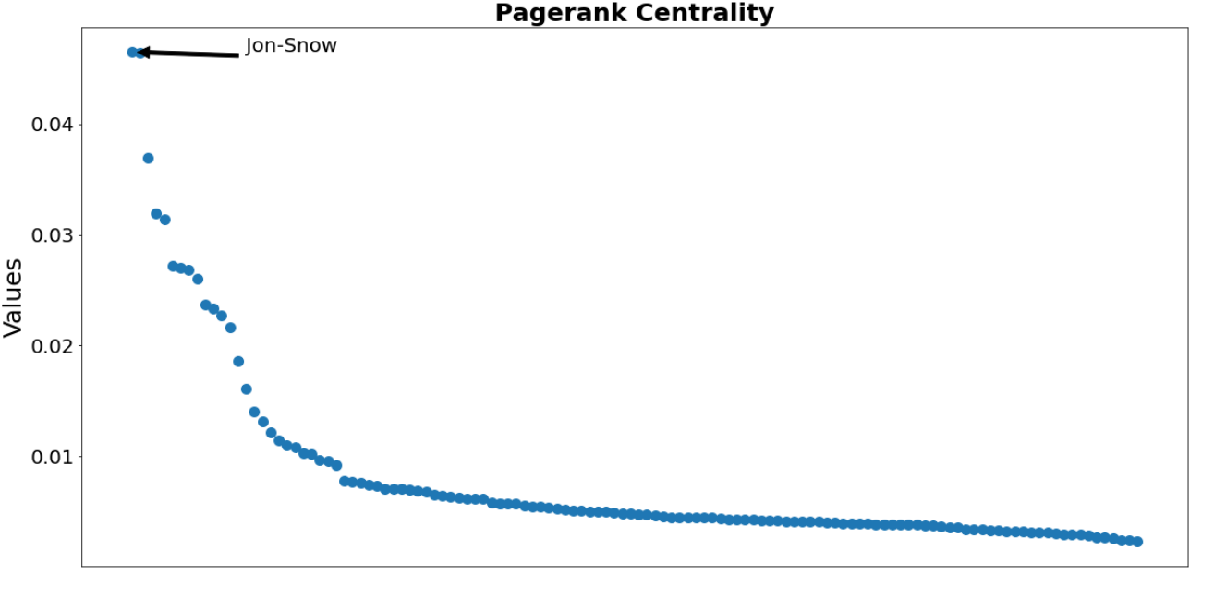
Centrality Measures

Slide 11
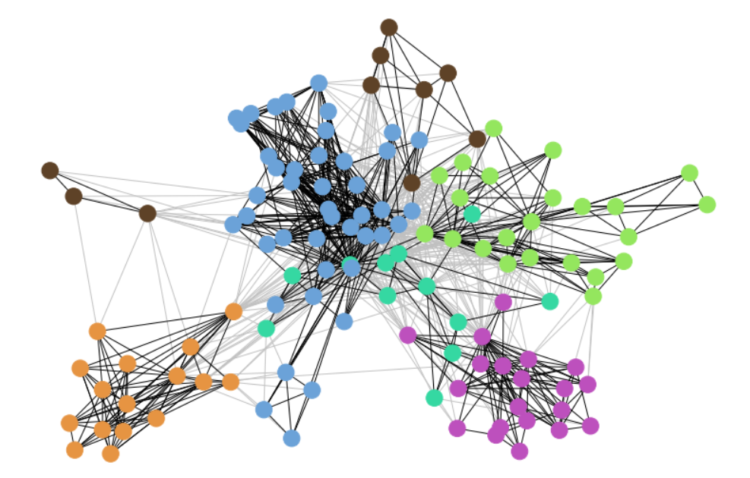
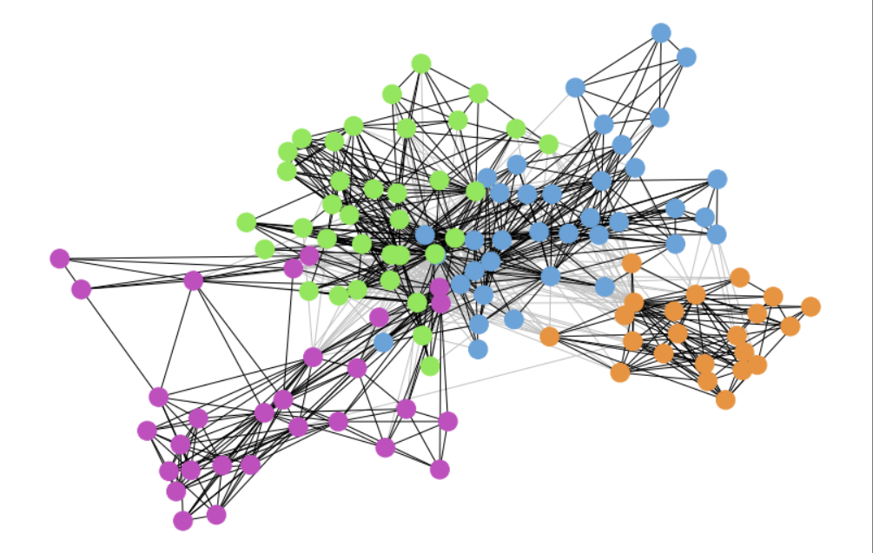
Community Detection
Louvain Algorithm (6)
Q = 0.477
CNM Algorithm (4)
Q = 0.39

Slide 12
03
Influence Maximization

Slide 13
Information flow models
Linear Threshold
Model
Independent Cascading Model
This model follows the accumulative nature of influence from peers.
There is a certain threshold that determines whether a node is active or not.
This model does not take into account the action of other nodes while considering a particular node
Every active node has an independent chance of activating the neighboring nodes.

Slide 14
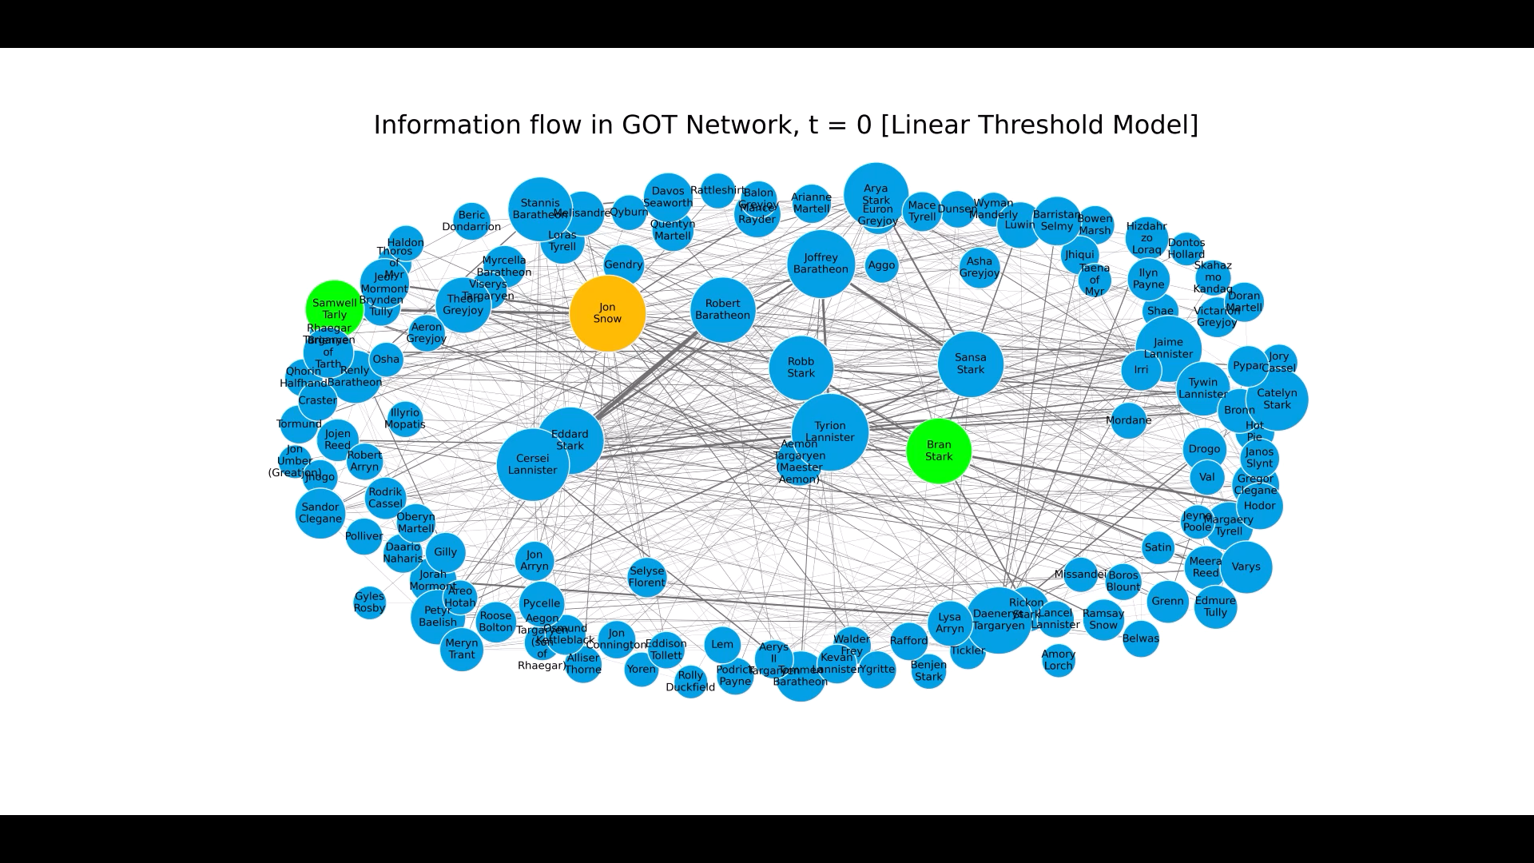
Linear Threshold Model [LTM]
Notes:
Video is generated by taking snapshots at successive time stamps.

Slide 15

Independent Cascading Model [ICM]
Notes:
Video is generated by taking snapshots at successive time stamps.

Slide 16
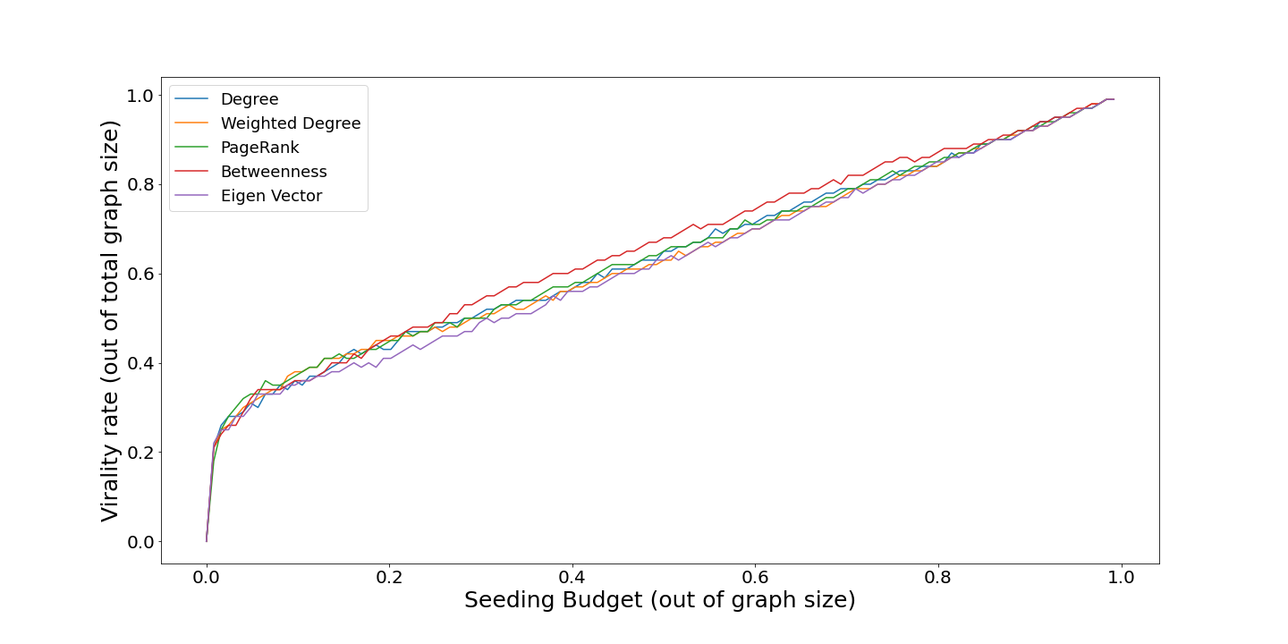
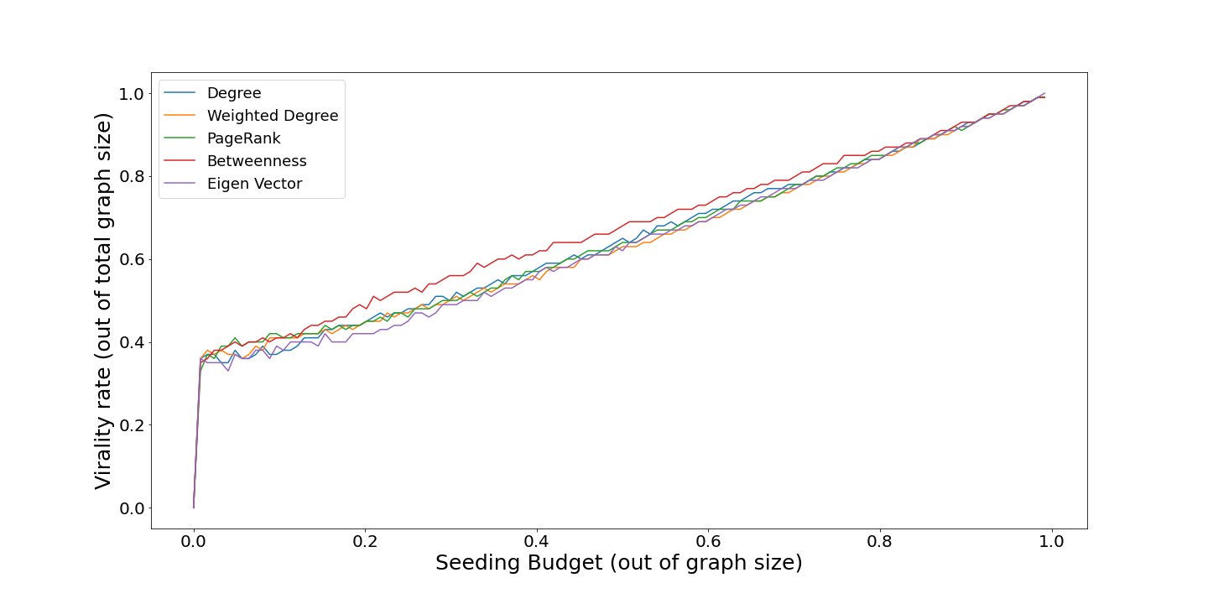
Budget Analysis
Linear Threshold Model
Independent Cascading Model

Slide 17
Budget Analysis
Take 2 nodes(all combinations) as active and check the spread in the network using both information spread models. Take the maximum spread as the most effective pair of nodes.
Independent Cascade: The best pair is Jon Snow and Arya Stark (>41%)
Linear Threshold: The best pair is Catelyn Stark and Renly Baratheon(>40%)
Key Takeaways:
For maximum spread, take nodes in disjoint spheres of influence.
The best performing pair need not be the top 2 values in any centrality measure as evident from comparing with virality plots.

Slide 18
Thanks

